Slide 1
Chapter 6:
Privacy and the
Government
A system that fails to respect its citizens’ right to privacy fails to respect the citizens
themselves. --Richard Nixon, 23-02-1974

Slide 2
Chapter Overview
Introduction
US legislation restricting information collection
Information collection by the government
Covert government surveillance
US legislation authorizing wiretapping
USA PATRIOT Act
Regulation of public and private databases
Data mining by the government
National identification card
Information dissemination
Invasion
1-<number>

Slide 3
Introduction-A Balancing Act
In 2005 a senior at UMass Dartmouth was finding Mao’s “Little Red Book”.
A student wanted to borrow Mao's "Little Red Book" from another library.
He filled out a library request with his:
  Name, Address, Phone number, Social Security Number
A few months later, Homeland Security agents visited him.
Why?
  The book was on a government watch list.
  The student had also traveled abroad.
The student had done nothing illegal, but his reading activity made him suspicious.
Key Lesson
  Governments collect information for national security.
  However, this can affect the privacy of innocent people.
  This shows the need to balance privacy and security.
Driver’s Privacy Protection Act (1994)
  Created to protect personal information in driver's license records.
  The law was introduced after the 1989 murder of actress Rebecca Schaeffer.
  An obsessed fan, Robert Bardo, obtained her home address through Department of Motor Vehicles (DMV) using her driver's license records..
  The incident showed that easy access to personal information can be dangerous.
  The law restricts who can access driver's personal information.
  Only authorized individuals or organizations can obtain DMV records for valid reasons.
  Goal: Protect people's privacy, safety, and security while preventing misuse of personal information.
  Key Message
1-<number>

Slide 4
Solove’s Taxonomy of Privacy
A Balancing Act
Governments need information to protect public safety and national security.
People also have the right to privacy and want their personal information protected.
Governments must balance privacy with safety and security.
After the 9/11 attacks(terrorist attacks on 9/11-usa), more security measures and monitoring were introduced. Two planes crashed into the Twin Towers of the World Trade Center in New York City.
The challenge is finding the right balance between protecting citizens and respecting their privacy.
Information collection: Activities that gather personal information
Information processing: Activities that store, manipulate, and use personal information that has been collected
Information dissemination: Activities that spread personal information
Invasion: Activities that intrude upon a person’s daily life, interrupt someone’s solitude, or interfere with decision-making
1-<number>

Slide 5
US Legislation Restricting Information Collection
Three examples of federal legislation that limits the amount of information private entities can collect from individuals.
1. Employee Polygraph [lie detector] Protection Act
In 1988, Prohibits private employers from using lie detector tests under most conditions
Cannot require test for major employment purposes
Exceptions
  Pharmaceutical companies and security firms may give test to certain classes of employees
  Employers who have suffered a theft may administer tests to reasonable suspects
  Federal, state, and local governments exempt
1-<number>

Slide 6
3. Genetic Information Nondiscrimination Act (2008)
2. Children’s Online Privacy Protection Act (2000)
Protects the online privacy of children. Applies to children under 12 years old.
Websites must get parental permission before collecting a child's personal information.
Reduces the amount of children's information collected online.
Helps keep children safer on the Internet.
Health Insurance Companies
  Cannot ask for your genetic information.
  Cannot use genetic information to deny or change health insurance.
  Does not apply to life or disability insurance.
Employers
  Cannot use genetic information when hiring, promoting, or firing employees.
  Protects people from genetic discrimination at work.
  Small businesses with fewer than 15 employees are exempt.
1-<number>

Slide 7
Information Collection by the Government
Look at ways in which the federal government itself has collected vast amounts of sensitive information about its citizens.
Census Records
Census collects information about people living in a country.
It helps the government plan services and ensure fair representation.
The number of census questions has increased over time.
Early census (1790) asked only a few basic questions
Later censuses collected more personal information.
Some people worry about privacy because the government stores large amounts of personal data
Example
1790 Census: Name and number of people in each household.
Later Census: Education, occupation, income, and housing information.
1-<number>

Slide 8
Census Records
  Today’s Census Question include:
    What is this person’s ancestry or ethnic origin?
    Does this person speak a language other than English at home?
    How many times has this person been married?
    How did this person usually get to work last week?
    Which fuel is used most for heating this house, apartment, or mobile home?
  Privacy of Census Data
    The Census Bureau must keep personal information confidential.
    However, in the past, census information was shared during national emergencies.
  World War I: Information about draft resisters was shared with the military(refused to serve in the military).
  World War II: Census data helped locate Japanese Americans.
1-<number>

Slide 9
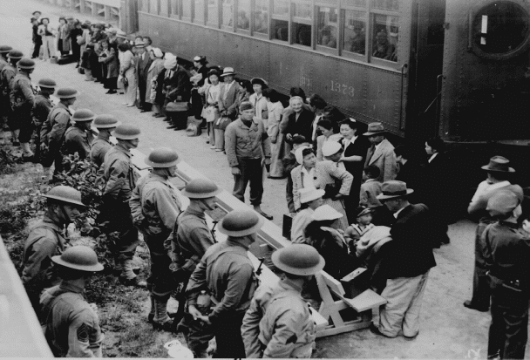
Internal Revenue Service Records
The IRS is the U.S. government agency that collects income taxes.
People must submit tax forms every year.
Tax forms contain personal and financial information, such as:
  Income (salary)
  Property and assets
  Donations to charities
  Medical expenses
The government must protect this information and keep it confidential.
If tax information is misused, it can violate a person's privacy.
Example
  During World War II, Japanese Americans were sent to internment camps.
  This case raised concerns about how government information could be used during national emergencies.
Japanese-Americans on Way to Imprisonment Camp in 1942
1-<number>

Slide 10
FBI National Crime Information Center 2000
NCIC is a national FBI database used by law enforcement.
  It stores information about crimes, criminals, and missing persons.
  The database has grown from 95,000 records to over 39 million records.
It includes information such as:
  Wanted criminals
  Missing persons
  Stolen vehicles and guns
  Criminal records and sex offenders
Purpose: Help police quickly identify suspects, solve crimes, and improve public safety.
1-<number>

Slide 11
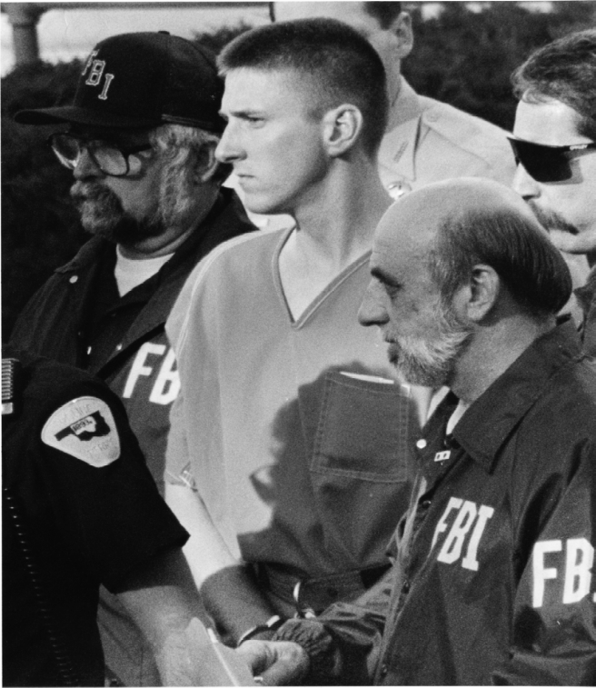
Successes of NCIC
Helps police solve many crimes every year.
Identifies wanted criminals quickly.
Finds missing children and adults.
Recovers stolen vehicles and property.
Stores fingerprint and criminal records.
Helped solve important criminal cases.
Supports police across the United States.
Improves public safety through faster information sharing.
Key Point: NCIC helps law enforcement solve crimes and protect the public.
1-<number>

Slide 12
Critics of NCIC
Incorrect records can lead to wrongful arrests.
People with the same name may be mistaken for suspects.
Some records include people who are not criminals.
Unauthorized users may misuse personal information.
Errors in the database can be difficult to correct.
Large databases raise privacy concerns.
Personal information must be protected.
Strong security and regular updates are necessary.
Main Point: NCIC is useful, but privacy and accuracy must be protected.
1-<number>

Slide 13
OneDOJ Database
Created by the U.S. Department of Justice.
Shares information with federal, state, and local police.
Includes police reports and investigation records.
Helps officers access information quickly.
Improves cooperation between law enforcement agencies.
Some records may contain incorrect information.
People not charged with crimes may still appear in reports.
Privacy and data accuracy are major concerns.
Key Point: OneDOJ improves information sharing but must protect privacy and ensure accurate records.
1-<number>

Slide 14
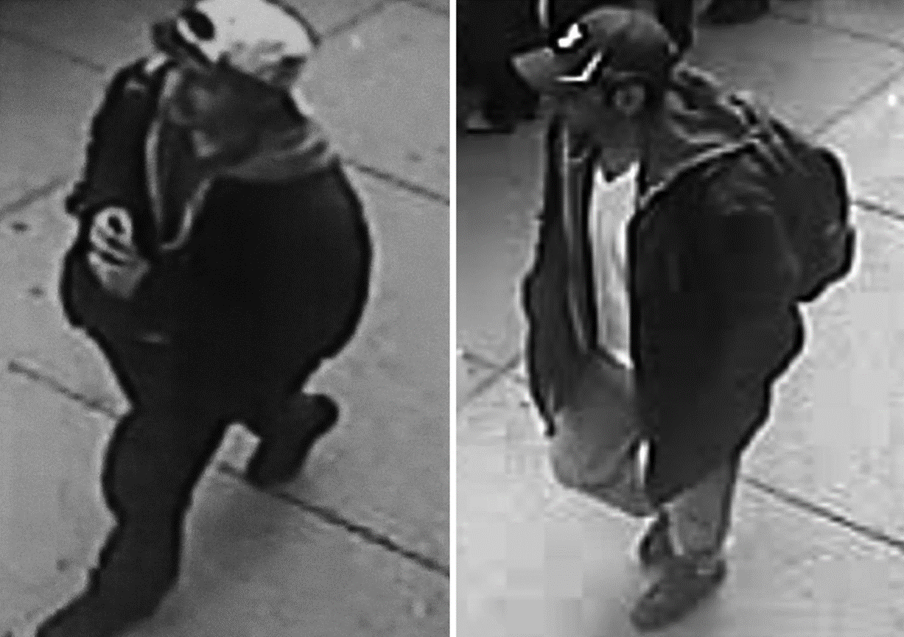
Closed-circuit Television Cameras
First use in Olean, New York in 1968
CCTV cameras monitor public places.
Help police prevent and investigate crimes.
Can identify suspects using video recordings.
Used in streets, malls, airports, and stations.
Some cities have thousands of CCTV cameras.
Many people believe cameras improve public safety.
Others worry they reduce personal privacy.
The effectiveness of CCTV is still debated.
Surveillance Camera Images of Boston Marathon Bombing Suspects
1-<number>

Slide 15
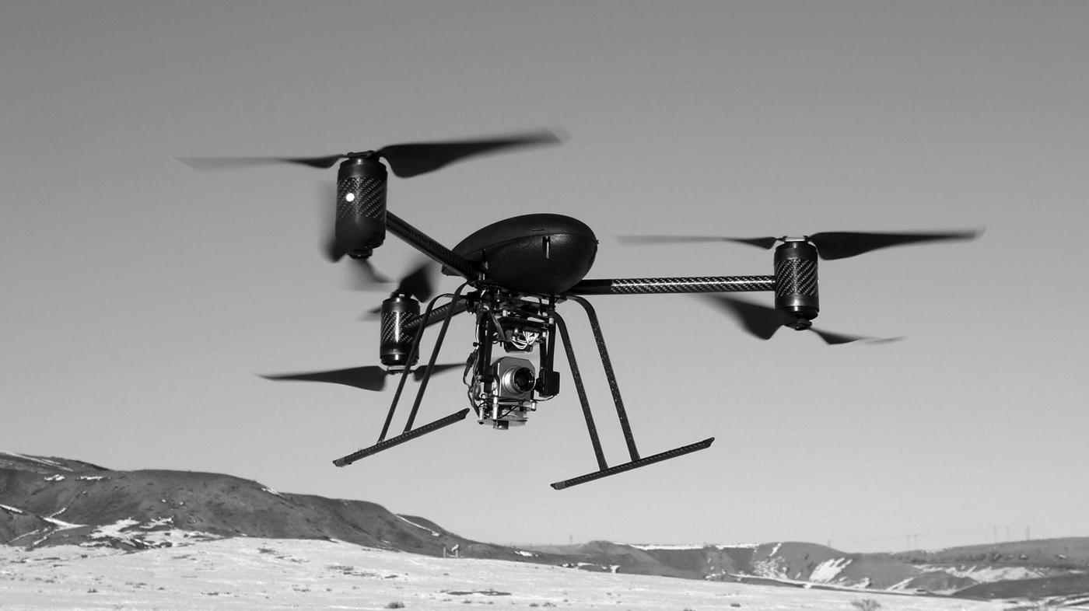
Police Drones
Police use drones to monitor areas from the air.
Useful for search and rescue operations.
Help during disasters and emergencies.
Can monitor traffic and crime scenes.
Drone use is regulated by aviation authorities.
Many people support drones for public safety.
Others worry about privacy and surveillance.
Some places require a search warrant before using drones.
Key Point: Police drones improve safety, but their use must respect people's privacy and legal rights
Should police be required to get a search warrant before surveillance of a residence?
Police Drone Surveillance Platform
1-<number>

Slide 16
Covert [Hidden] Government Surveillance
4th Amendment to US Constitution
Government secretly collects information about people.
Used to prevent crime and protect national security.
The 4th Amendment protects people from unreasonable searches.
Police usually need a search warrant approved by a judge.
Secret surveillance without permission may violate privacy.
Government must balance security and privacy.
Surveillance is allowed only in certain legal situations.
  Example: Police obtain a court warrant before monitoring a suspect's phone.
  Example: Secretly spying on an innocent person without a warrant is illegal.
Key Point: Government surveillance should follow the law and respect privacy rights.
1-<number>

Slide 17
Wiretaps and Bugs
Wiretap: Secretly listening to telephone conversations.
Bug: Hidden microphone used to record conversations.
Early court decisions allowed some wiretapping.
Later laws placed restrictions on wiretapping.
Courts ruled that people have a reasonable expectation of privacy.
Police usually need a warrant before wiretapping.
Illegal wiretapping can violate privacy rights.
  Example: Police get a warrant to monitor a kidnapper's phone.
  Example: Secretly recording someone's private conversation without permission is illegal.
Key Point: Wiretapping is allowed only under legal procedures.
1-<number>

Slide 18
Operation Shamrock
U.S. surveillance program started after World War II.
Managed by the National Security Agency (NSA).
Collected international telegrams and later phone calls.
Used to gather national security information.
Expanded to monitor suspected criminals and spies.
Some anti-war protesters were placed on watch lists.
Helped investigate national security threats.
Raised concerns about privacy and government power.
Later criticized for collecting information without people's knowledge.
Key Point: Operation Shamrock improved security but raised privacy concerns.
1-<number>

Slide 19
Carnivore Surveillance System
Created by the FBI in the late 1990s.
Monitored Internet traffic and emails.
Captured data sent to and from a specific IP address.
Used during criminal investigations.
Helped collect digital evidence.
Required cooperation from Internet service providers.
Raised concerns about privacy and surveillance.
Later replaced by newer commercial software.
  Example: FBI monitored emails of a cybercrime suspect.
Key Point: Carnivore helped investigate online crimes but created privacy concerns.
1-<number>

Slide 20
Covert Activities after 9/11
Began after the September 11, 2001 terrorist attacks.
Government increased secret surveillance to improve security.
NSA monitored some international phone calls and emails.
Some surveillance was done without search warrants.
Thousands of people were monitored.
Helped prevent some terrorist plots.
Raised debates about privacy and civil rights.
Governments must balance security with individual freedom.
  Example: Monitoring communications of suspected terrorists.
Key Point: After 9/11, security increased, but privacy concerns also increased.
1-<number>

Slide 21
TALON [Threat and Local Observation Notices] Database
Created by the U.S. Department of Defense in 2003.
Stored reports about suspicious activities near military bases.
Reports came from military staff and civilians.
Used to identify possible security threats.
Included reports about protests and public activities.
Some innocent people were included in the database.
Many reports were later removed.
The TALON program ended in 2007.
  Example: A person reporting suspicious activity near a military base.
Key Point: TALON aimed to improve security but raised concerns about privacy and collecting information about innocent people.
1-<number>

Slide 22
US Legislation Authorizing Wiretapping
In 1968, crime and public unrest increased in the U.S.
Police wanted permission to use wiretapping to investigate crimes.
Congress passed laws allowing wiretapping in certain cases.
Wiretapping is only allowed under legal rules.
A court order is usually required before listening to phone calls.
The law protects both public safety and privacy.
Unauthorized wiretapping is illegal.
  Example: Police obtain a warrant to monitor a kidnapping suspect's phone.
  Example: Secretly listening to someone's calls without permission is illegal.
Key Point: Wiretapping is allowed only when approved by law.
1-<number>

Slide 23
Title III
Title III (1968)
Part of the Omnibus Crime Control and Safe Streets Act.
Regulates wire, oral, and electronic surveillance.
Police must obtain a court warrant before wiretapping.
Court orders usually allow monitoring for up to 30 days.
Protects the privacy of citizens.
Controls how collected information can be used.
The Supreme Court later rejected warrantless wiretapping.
Example: Police receive a judge's approval before monitoring a suspect's phone.
Example: Monitoring a phone without a warrant is generally illegal.
Key Point: Title III allows legal wiretapping with court approval.
1-<number>

Slide 24
Foreign Intelligence Surveillance Act (FISA)
Passed to monitor foreign intelligence activities.
Allows surveillance of foreign agents for national security.
A special FISA Court reviews surveillance requests.
U.S. citizens usually require court approval before monitoring.
Expanded after 2007 for some foreign communications.
Helps prevent terrorism and espionage.
Example: Monitoring communications of a suspected foreign spy.
Example: Court approval is needed before monitoring a U.S. citizen.
Key Point: FISA balances national security with privacy rights.
1-<number>

Slide 25
Secret PRISM Program
A secret NSA surveillance program.
Revealed by Edward Snowden in 2013. Collected information from major Internet companies.
Allowed access to emails and online communications.
Used to monitor foreign intelligence targets.
Raised global privacy concerns.
Many technology companies denied direct involvement.
  Example: Monitoring emails linked to suspected terrorists.
Electronic Communications Privacy Act
Protects electronic communications.
Allows police to use legal surveillance tools.
Requires a court order in many investigations.
Introduced pen register and trap-and-trace devices.
Allows roving wiretaps for suspects using multiple phones.
Balances law enforcement needs and privacy.
Covers phone and electronic communications.
Example: Tracking numbers dialed by a crime suspect
1-<number>

Slide 26
Stored Communications Act
Part of the Electronic Communications Privacy Act.
Covers emails and data stored online. Protects information stored by Internet providers.
Older stored emails may be accessed under certain legal rules.
Cloud storage created new privacy challenges.
Privacy groups requested stronger protections.
  Example: Police request access to stored emails during an investigation.
Communications Assistance for Law Enforcement Act
Passed in 1994.
Helps police legally conduct wiretaps on digital networks.
Requires telecom companies to support lawful surveillance.
Applies to modern telephone systems.
Allows interception of digital communications with legal approval.
Helps investigators keep up with new technology.
Privacy advocates raised concerns about increased surveillance.
Example: Police legally intercept calls during a criminal investigation.
Key Point: CALEA supports lawful surveillance while raising important privacy debates.
1-<number>

Slide 27
USA PATRIOT [Uniting and Strengthening America by Providing Appropriate Tools Required to Intercept and Obstruct Terrorism] Act
Passed after the September 11, 2001 terrorist attacks.
Gives law enforcement more power to investigate terrorism.
Allows greater monitoring of phone calls, emails, and Internet activity.
Strengthens banking rules to stop money laundering.
Increases border security and immigration checks.
Introduces stricter penalties for terrorist crimes.
Critics say it reduces privacy and weakens 4th Amendment rights.
Allows roving surveillance (following suspects across devices).
In some cases, allows searches with fewer legal restrictions.
  Example: Police monitor a terrorism suspect's phone and email to prevent an attack.
Key Point: The PATRIOT Act improves national security but raises privacy concerns.
1-<number>

Slide 28
Patriot Act Successes
Helped investigate many terrorism-related cases.
Hundreds of suspects were charged after 9/11.
Many suspects were convicted or pleaded guilty.
Helped deport people linked to terrorism investigations.
Assisted in breaking up suspected terrorist groups.
Improved information sharing between government agencies.
Helped prevent some planned terrorist attacks.
  Example: Authorities stopped groups planning to support terrorist organizations.
Key Point: Supporters believe the Act improved national security and prevented terrorism.
1-<number>

Slide 29
Patriot Act Failure
In 2004, Madrid train bombings were investigated.
The FBI wrongly identified Brandon Mayfield as a suspect.
His home was secretly searched and monitored.
He was arrested based on a fingerprint mistake.
Spain later identified the real suspect.
Brandon Mayfield was released after the mistake was discovered.
The FBI officially apologized.
Civil rights groups said he was unfairly targeted because of his religion.
Lesson: Surveillance mistakes can affect innocent people.
  Key Point: Strong security powers must be balanced with protecting individual rights.
1-<number>

Slide 30
Patriot Act Renewal
Most parts of the USA PATRIOT Act became permanent.
Three important provisions were renewed:
  Roving wiretaps – follow a suspect across different phones or devices.
  Lone wolf surveillance – monitor suspected terrorists acting alone.
  Business records access – allows the FBI to obtain records from many organizations with legal approval.
Example: The FBI can collect phone, bank, or library records during a terrorism investigation.
In May 2011, President Barack Obama signed a 4-year extension of these provisions.
Supporters say these powers help prevent terrorism.
Critics say they may reduce personal privacy and civil liberties.
Debate continues between national security and privacy rights.
1-<number>

Slide 31
Regulation of Public and Private Databases
Genesis of Code of Fair Information Practices
In 1965, the U.S. government studied problems with managing large databases.
Experts suggested creating a National Data Center.
Many citizens worried that one large database could threaten privacy.
The government created another committee to develop privacy guidelines.
These guidelines became the Code of Fair Information Practices.
The goal was to protect personal information from misuse.
It encouraged fair and responsible use of personal data.
It became the foundation for future privacy laws.
Example: A government database should collect only necessary information and protect it from misuse.
1-<number>

Slide 32
Code of Fair Information Practices (1974)
Introduced rules to protect personal information.
No organization should keep secret databases.
People have the right to see their own personal records.
Organizations must get consent before using data for a new purpose.
People can correct or update incorrect information.
Database owners must keep information accurate and secure.
Personal information should not be misused.
These principles became the basis for many privacy laws.
  Example: If your address is incorrect in a database, you have the right to request a correction.
1-<number>

Slide 33
Privacy Act of 1974 Falls Short
The Privacy Act was based on Fair Information Practice principles.
It applies only to U.S. government databases.
It protects records identified by a person's ID.
There was no single official responsible for enforcing the law.
Government agencies could still share some records with each other.
It did not apply to private companies.
Some privacy protections were considered incomplete.
Because of these limits, stronger privacy laws were later introduced.
  Example: The law protects records held by a government agency, but not personal data stored by a private social media company.
1-<number>

Slide 34
Legislation for Private Institutions
Three important laws were passed to protect consumers' personal and financial information.
1. Fair Credit Reporting Act
Protects the accuracy and privacy of credit information.
Applies to credit bureaus such as Equifax, Experian, and TransUnion.
Negative credit information is usually kept for 7 years.
  Late payments or unpaid debts usually stay on your credit report for 7 years
Bankruptcy records may remain for 10 years.
Criminal convictions may stay on records indefinitely.
People can request and review their credit reports.
The law helps prevent unfair credit decisions. People can dispute incorrect information.
1-<number>

Slide 35
2. Fair and Accurate Credit Transactions Act
Passed in 2004.
Gives consumers one free credit report every year.
Reports must be requested by the consumer.
Helps reduce identity theft.
Allows fraud alerts on credit reports.
Gives victims of identity theft extra protection.
Encourages people to check their credit regularly.
Helps detect errors before applying for loans.
Example: If someone uses your identity to open a credit card, you can place a fraud alert on your credit report.
1-<number>

Slide 36
3. Financial Services Modernization Act
Passed in 1999.
Allows banks, insurance companies, and investment firms to work together.
Requires companies to explain their privacy policies.
Customers must be informed about how their data is used.
Customers can opt out of some information sharing.
Financial companies must protect customer information.
Encourages secure handling of personal and financial data.
Helps reduce unauthorized access to customer information.
  Example: A bank must tell customers if it shares their personal information with another company and give them the option to refuse.
1-<number>

Slide 37
Data Mining by the Government
Data mining means searching large databases to find useful patterns.
Governments use data mining to detect fraud and suspicious activities.
It helps analyze large amounts of information quickly.
Data from different databases can be compared.
It is widely used in tax, health, and security systems.
It can identify unusual behavior automatically.
It improves decision-making and investigations.
Privacy concerns arise if personal data is misused.
  Example: A government compares bank records with tax records to detect tax fraud.
1-<number>

Slide 38
IRS (Internal Revenue Service) Audits
The IRS uses computers to detect possible tax fraud.
It uses a Discriminant Function (DIF) score to identify unusual tax returns.
Higher DIF scores are more likely to be audited.
The IRS compares tax forms with employer and bank records.
Data mining helps find missing or incorrect information.
It identifies people who may have underpaid taxes.
Most audits are selected using computer analysis.
This system improves fairness and efficiency.
  Example: If a person reports very low income but has very high bank deposits, the IRS may investigate.
1-<number>

Slide 39
Syndromic Surveillance Systems
Uses data mining to detect disease outbreaks early.
Collects information from many different sources.
Monitors 911 calls and emergency room visits.
Tracks school absences and medicine purchases.
May also analyze Internet health searches.
Looks for unusual health patterns.
Helps public health officials respond quickly.
Can detect epidemics or bioterrorism threats.
Example: In 2002, New York detected a Norwalk virus outbreak after many people visited hospitals with vomiting and diarrhea.
1-<number>

Slide 40
Telecommunications Records Database
Created by the NSA after the 9/11 attacks.
Stored phone call records of millions of Americans.
Used calling patterns to detect terrorist networks.
Major telephone companies provided call records.
The program became public in 2006.
USA Today revealed existence of database in May 2006
Several dozen class-action lawsuits filed against the tel. companies
August 2006: Federal judge in Detroit ruled program illegal and unconstitutional
July 2007: US Court of Appeals overturned ruling, saying plaintiffs did not have standing to bring suit forward. They had not produced any evidence that they were victims of warrantless wiretapping.
  Example: If two suspected terrorists frequently call each other, the system may identify the connection.
1-<number>

Slide 41
Predictive Policing
Uses data mining to predict where crimes may happen.
Analyzes past crime patterns and trends.
Finds crime hotspots with high crime rates.
Helps police decide where to patrol.
Considers crime location and time.
Aims to prevent crimes before they occur.
Improves the use of police resources.
Raises concerns about fairness and privacy.
  Example: Police in Santa Cruz, California identified 15 crime hotspots and sent more officers to those areas
1-<number>

Slide 42
National Identification Card
Every person should have a unique identification number.
A unique ID can be used across different databases.
Reduces confusion caused by people having the same name.
Used by governments for identity verification.
Can improve access to government services.
Raises privacy concerns if data is shared widely.
  Example: A national ID number can be used in hospitals, banks, and passport offices.
1-<number>

Slide 43
Social Security Number
Social Security cards first issued 1936
Originally used only for Social Security purposes
Use of SSN has gradually increased
SSN is a poor identification number
  Not unique: Some early SSNs were accidentally duplicated.
  Rarely checked: Identity information was not always carefully verified..
  No error-detecting capability: SSNs have no built-in error-checking feature.
Misuse of SSNs can lead to identity theft.
  Example: Someone using another person's SSN to apply for a loan is committing identity theft.
1-<number>

Slide 44
Arguments for National ID Card
Provides more reliable identification.
May reduce illegal immigration.
Helps prevent unauthorized employment.
May help reduce certain crimes.
Makes identity verification easier.
Arguments against National ID Card
No ID system is 100% accurate.
Biometrics can still make mistakes.
May not significantly reduce crime.
Makes government data mining easier.
Increases privacy concerns.
Centralized databases may be hacked.
A doctor mistakenly records that a patient has a serious illness. Later, insurance companies or other doctors may believe this incorrect information, and it can be difficult to have the record corrected.
1-<number>

Slide 45
The REAL ID Act
Signed in May 2005. To date, this law has not been put into effect.
Significantly changes driver’s licenses in the US
New licenses
  Issued by end of 2013
  Required to open bank account, fly on commercial airplane, or receive government service
  Requires applicants to supply 4 different IDs to have this Driving license
  Will probably contain a biometric identifier
  Must contain data in machine-readable form
Most states missed 2013 deadline; temporary delays being granted
Possible Consequences of New Licenses
Improves identity verification.
Makes it harder for criminals to use fake identities.
Helps law enforcement identify suspects.
Reduces document fraud.
May increase identity theft if databases are breached
1-<number>

Slide 46
Information Dissemination
Means sharing or releasing information.
Laws protect personal information from misuse.
Some laws allow public access to government records.
Educational and medical records receive special protection.
Information should only be shared with permission.
Public records may be released under certain laws.
Privacy laws balance access and confidentiality.
Unauthorized sharing can violate privacy rights.
  Example: A school cannot release a student's grades without permission.
Family Education Rights and Privacy Act (FERPA)
Protects students' educational records.
Applies to students aged 18 and older.
Parents have rights for younger students.
Students can inspect their records.
Students can request correction of errors.
Schools need permission before releasing records.
Protects academic privacy.
Applies to schools receiving federal funding.
  Example: A university cannot share a student's grades with an employer without consent.
1-<number>

Slide 47
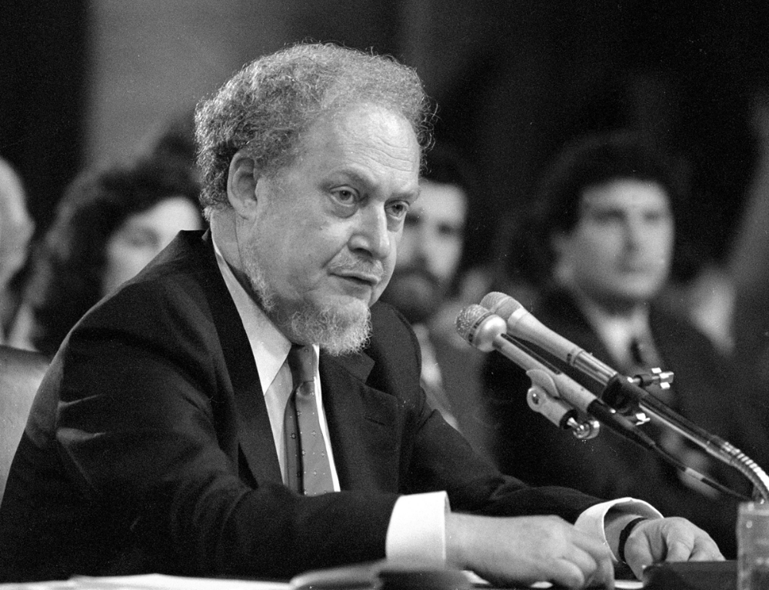
Judge Robert Bork
Video Privacy Protection Act
Protects customers' video rental records.
Requires written consent before sharing rental history.
Rental companies must protect customer privacy.
Personal rental information must be deleted when no longer needed.
Prevents unauthorized disclosure.
1-<number>

Slide 48
Health Insurance Portability and Accountability Act(HIPAA)
Protects patients' medical information.
Doctors and hospitals cannot share medical records without the patient's permission.
Healthcare providers must explain how they use medical information.
Patients can view their medical records.
Patients can ask to correct mistakes in their records.
Example: A hospital cannot send your medical records to a bank without your written permission.
1-<number>

Slide 49
Freedom of Information Act
Federal law designed to ensure public has access to US government records
Signed by President Johnson (1966)
Applies only to executive branch of the federal government, not the legislative or judicial branches.
Nine exemptions: For example, a document may be withheld if it has been classified as:
  Secret for national defense or foreign policy reasons, containing trade secrets or confidential commercial or financial information. Or exemption deals with documents related to law enforcement investigations.
Toll Booth Records
بوابة التعريف المرورية
E-ZPass: an automatic toll-collection system used on most toll roads, bridges, and tunnels between Illinois and Maine.
Drivers with E-ZPass tags pass through without stopping to pay attendant
Records have been provided in response to court orders in criminal and civil cases.
1-<number>

Slide 50
Invasion
Privacy means having a personal space where others cannot access your information without permission.
Sometimes, people share their personal information to use online services, apps, or websites. This may reduce their privacy.
Governments create laws to protect privacy, such as:
  Do Not Call Registry – Stops unwanted telemarketing calls.
  CALM Act – Keeps TV advertisements at the same volume as TV programs.
Some government actions can also reduce privacy for security reasons.
Invasive government actions
  Requiring citizen identification to purchase pseudoephedrine.
  Advanced Imaging Technology scanners at airports.
1-<number>

Slide 51
National Do Not Call Registry
Created by the FTC in 2003.
People can register their phone numbers for free.
Registered numbers receive fewer telemarketing calls.
Protects people's privacy from unwanted calls.
Millions of people registered before the service started.
  Example: If you register your number, a telemarketing company should not call you.
Commercial Advertisement Loudness Mitigation (CALM) Act
Many people complained that TV commercials were too loud.
The CALM Act was signed in 2010.
It requires TV commercials to have the same volume as TV programs.
The FCC checks that TV stations follow this rule.
Helps make TV viewing more comfortable.
  Example: A commercial shown during a movie should not suddenly become much louder than the movie.
1-<number>

Slide 52
Pseudoephedrine Purchases
Pseudoephedrine is an ingredient in many cold medicines (such as Sudafed).
It can also be used to make the illegal drug methamphetamine (meth).
Laws limit how much pseudoephedrine a person can buy each month.
Most states require buyers to show an ID and provide a signature.
These rules help reduce illegal drug production.
  Example: When buying certain cold medicines, the pharmacist may ask for your ID and signature.
1-<number>

Slide 53
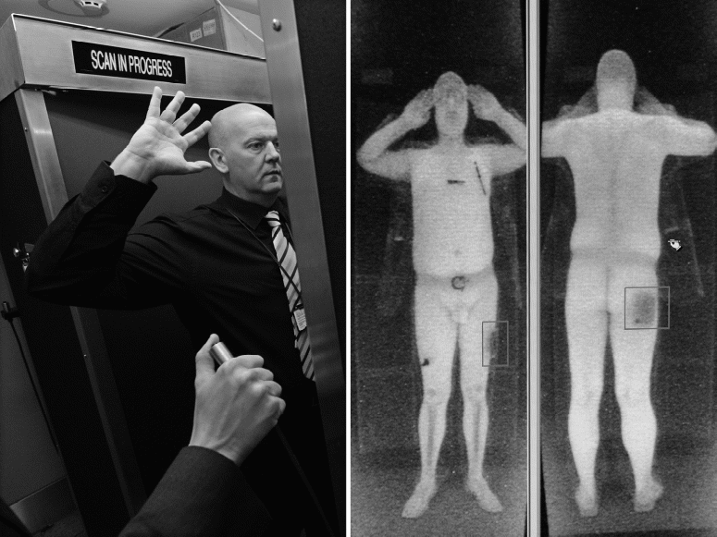
Advanced Imaging Technology Scanners
TSA introduced AIT scanners at airports in 2007.
Early scanners showed detailed body images, causing privacy concerns.
In 2010, a privacy organization sued the government over the scanners.
TSA later replaced detailed images with simple body outlines.
By 2013, all scanners showing detailed passenger images were removed.
  Example: At airport security today, body scanners display a generic outline instead of a detailed body image.
© PAUL ELLIS/AFP/Getty Images/Newscom
1-<number>

Slide 54
In-Class Discussions
1. Private Databases
The Code of Fair Information Practices applies only to government databases.
Discussion:
Should the same privacy rules also apply to private companies (such as banks, hospitals, and online businesses)?
  What are the advantages?
  What are the disadvantages?
2. DNA Database
Discussion:
Should the government create a DNA database for every citizen and allow researchers and police to use it?
  What are the benefits?
  What privacy concerns could it create?
3. National ID Card
Discussion:
Should everyone be required to carry a national identification (ID) card?
  What are the advantages?
  What are the disadvantages?
4. TALON Database
The TALON database was created to collect information about possible security threats.
Discussion:
Do you think the TALON database protects national security, or does it reduce people's freedom of speech?
  Explain your opinion with reasons.
1-<number>

